Slide 1
MODULES IN JAVASCRIPT
Sai Vardhan T

Slide 2
Modules in JavaScript
Module is nothing but a file or a script file
Modules will split code into multiple files
Types in Modules
Import
Export

Slide 3
Import & Export
Import:
This allows us to import the functionality from other modules.
Syntax:
Import {functions/variables/classes} from “./location.js”;
Export:
This allows us to export a particular property from the current module to another module.
Syntax:
Export functions/variables/classes

Slide 4
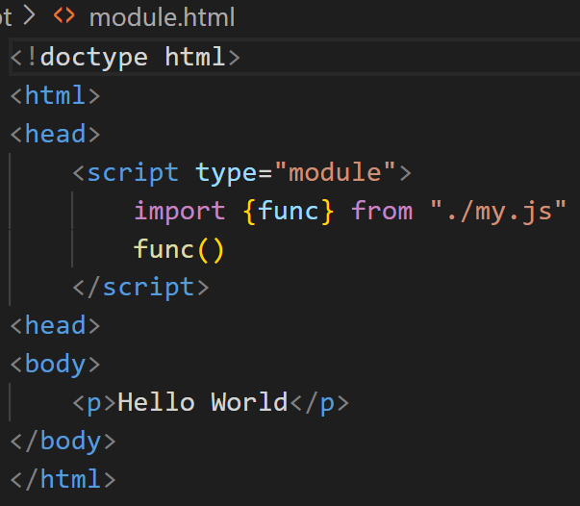
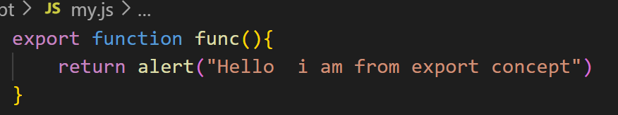
Exporting / Importing of Functions

Slide 5
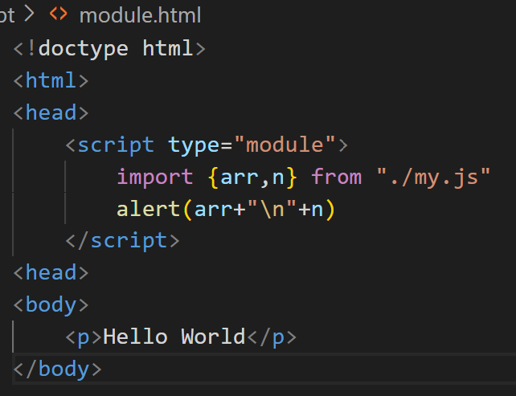
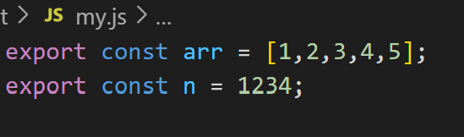
Exporting / Importing of variables

Slide 6
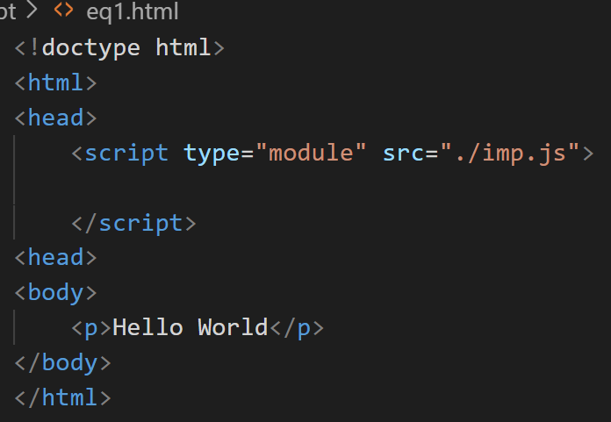
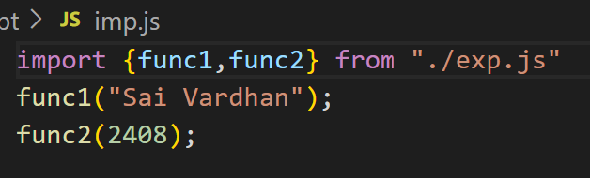
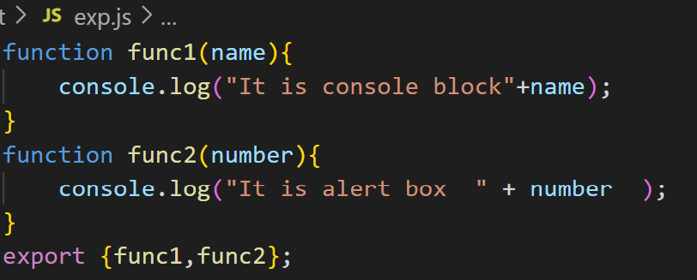
Importing / Exporting through multiple files

Slide 7
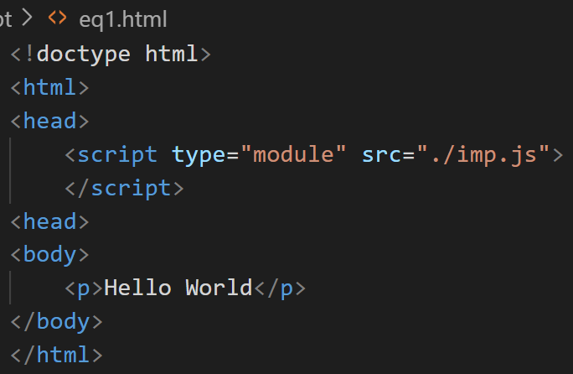
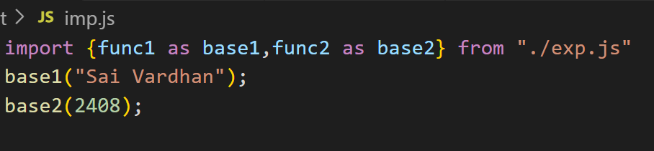
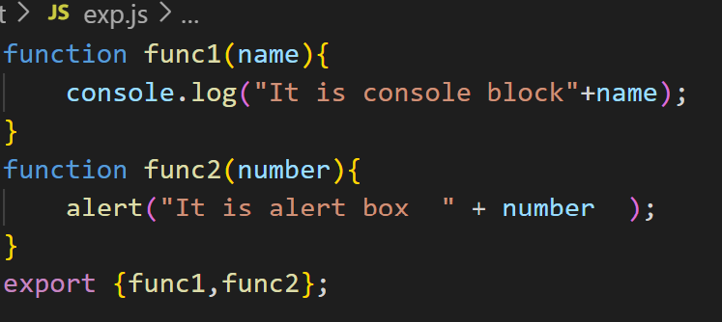
Renaming Feature in Importing

Slide 8
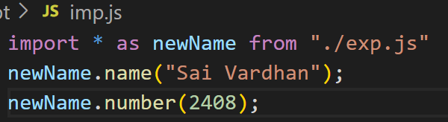
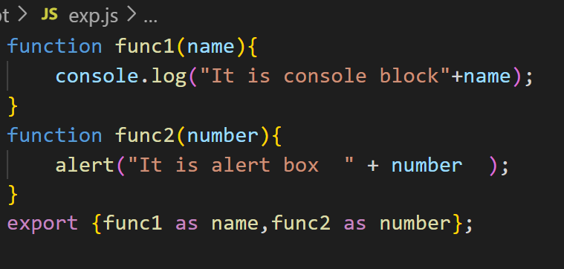
Renaming Feature in Exporting

